Slide 1
Early Literacy Approach: Better Start Literacy Approach

Slide 3
BETTER
START
LITERACY
APPROACH
WHĀNAU ENGAGEMENT
Strengths Based
TEACHER PLD
MICRCREDENTIAL
COACHING
MONITORING
ASSESSMENTS
Building foundational skills to foster early literacy success
Response to Better Start Literacy Approach
RESOURCES FOR EARLY LITERACY SUCCESS

Slide 4
Features of teaching content
Evidence-based phonological awareness teaching integrated with letter knowledge
Co-constructed with class teachers, informed by parent and child feedback
Evidence based vocabulary teaching
Culturally responsive
Language, identity and culture of Māori and Pasifika learners is affirmed.
Oral language and listening comprehension
Small group reading: Ready to Read Phonics Plus
Scope and Sequence to introduce word patterns within NZ story contexts

Slide 5
Response to intervention framework
Tier 1: Class literacy teaching + small group reading
45minutes 4 X Weekly
10 teaching weeks
Tier one ‘Universal’: Class phonological awareness and vocab teaching & differentiated small group
reading (Phonics+) implemented by class teacher
Tier two ‘Targeted’: Small group instruction (max of 5 per group) – support from literacy specialist
Tier three ‘Individualised’: Individual or in pairs by speech language pathologist or literacy specialist

Slide 6
Online Monitoring Assessments
Phonological Awareness:
Initial phoneme identity, phoneme segmentation, phoneme blending (English)
Letter Sound Knowledge and Word Decoding measures
Oral Language:
Story retell and listening comprehension
Integrated Reporting:
Parents- individual child progress report
Teacher - class level progress report
Leaders – across classes

Slide 7
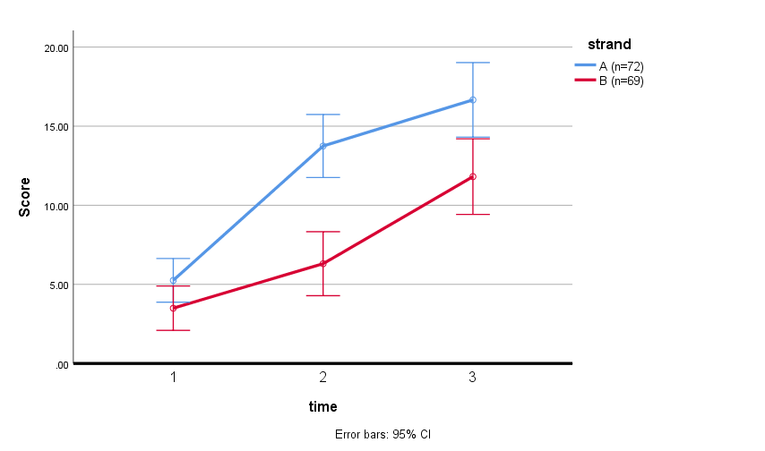
5 year old children with low oral language: Decoding ability (Gillon et al 2019)
*
**
Strand A (n= 72) received Better Start Literacy Approach first T1 to T2
Strand B (n= 69) received other curriculum first T1- T2 then received BSLA T2- T3
** p < .001, d = 0.87; * p<.05, d = 0.6

Slide 8
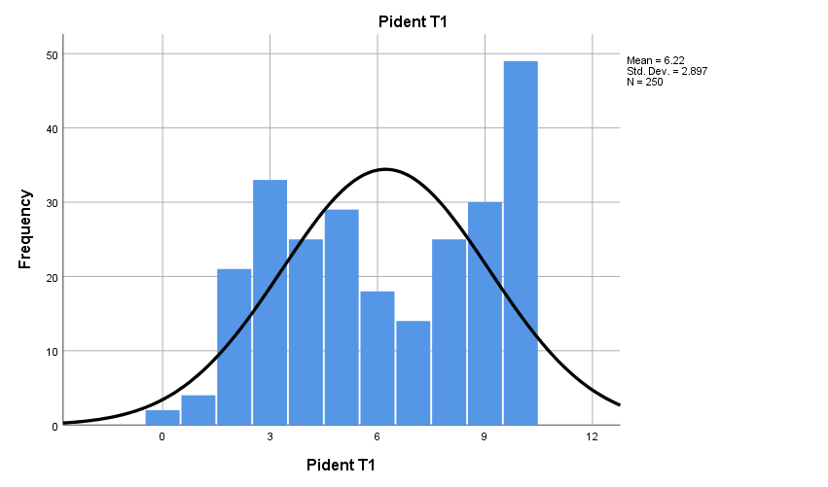
Initial Phoneme Identity (identify the first sound in a word) School entry
250 children: aged 5.0 to 5.03
Mean = 6
SD = 2.9
Significantly above chance
Items correct / 10

Slide 9
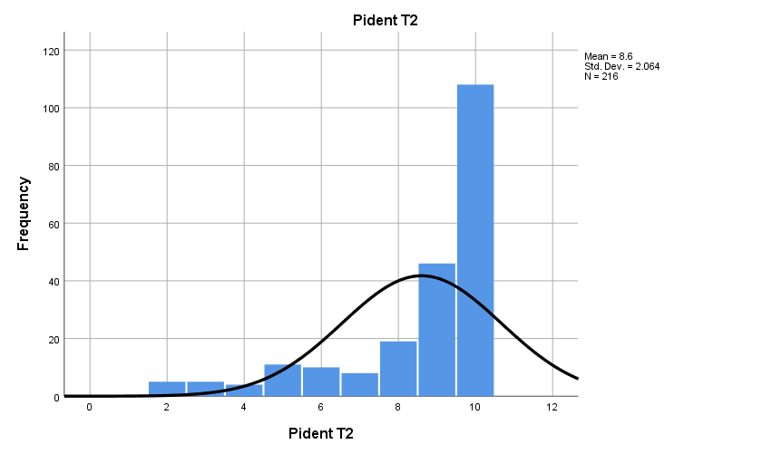
Initial Phoneme Identity Time 2: After 10 weeks of the Better Start Literacy Approach
Mean = 8.6
SD = 2.1
N = 216

Slide 10
Micro-credential Model
Literacy specialists and teachers working together
Facilitator micro-credential
Teacher micro-credential
Most of the hours involved in the micro-credential is hours in the classroom (teachers) or hours supporting teachers (facilitators/literacy specialists)
The aim of the approach is support both teachers and facilitators towards independence in implementing a structured literacy approach

Slide 11
Literacy specialists learn about BSLA and support teachers
Receive support from University of Canterbury in BSLA content and coaching
Provide support to teachers
Literacy Specialist
Receive support from literacy specialists to use and apply BSLA in their classrooms
Teachers

Slide 12
Spreading the expertise…
Literacy specialist
Cohort 1 teachers
Cohort 2 teachers
Cohort 3 teachers
+
+
+
Foundation teachers influence literacy teaching at all levels in their school

Slide 13
What does Ministry support cover?
The University of Canterbury online learning fee for each class teacher and each literacy specialist.
Information kits and access to all online resources for each teacher and literacy specialist.
Two release days per class teacher.
Workshop travel and accommodation for literacy specialists.
The Ministry is funding UC directly so schools don't have to make any payments. UC will administer funding for teacher release days.

Slide 14
Priorities for selection for funding support:
All schools may apply, but for cohort one priority will be given to:
schools decile 1 - 5,
Kāhui Ako and cluster applications,
schools participating in the School Entry Kete trial.

Slide 15
The selection process – the short version
Talk with cluster and Kāhui Ako about BSLA opportunity
Identify specialists and teachers to be involved
Complete application form
Schools

Slide 16
Where to go next …
For more information
University of Canterbury site:
Better Start Literacy Approach | University of Canterbury
PLD site from 10 May:
https://pld.education.govt.nz/find-pld/bsla-professional-support
Email enquiries:
Foundational.learning@education.govt.nz

